Slide 1
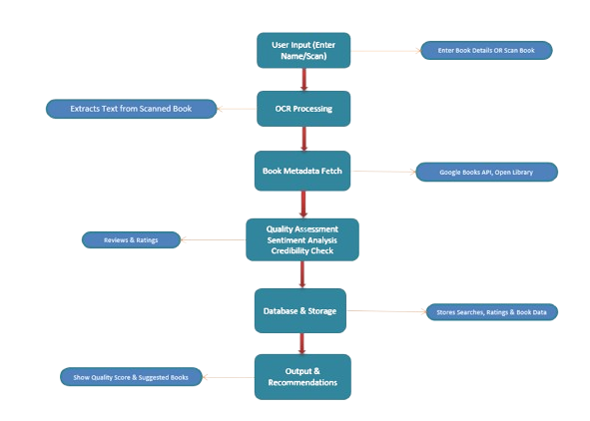
MIT SCHOOL OF COMPUTING
Class : TYCORE6 Group Id: 608
DEPARTMENT OF COMPUTER SCIENCE & ENGINEERING
BookIQ
Amit Nishankar ,Goutam Kumar, Khwaish Agarwal, Naman Babbar
Faculty Guide:
Prof. Nilesh Kulal
Empathy Chart
Ideation
Despite the abundance of textbooks, selecting the right one remains a challenge for students and educators. Many invest time and money in books only to find them outdated or ineffective. To solve this, I envisioned a Textbook Quality Assessment Application—an AI-powered tool that analyzes book quality through OCR, reviews, and structured insights, ensuring smarter academic choices and a seamless learning experience.
Block Diagram
User Segment:
User Feels:
Students struggling to find quality study materials.
Frustrated by outdating or misleading content. -
.
Educators seeking reliable reference books
Overwhelmed by too many book options
Researchers needing credible academic resources
Eager for a smarter book selection process.
User
User Thoughts:
User Action:
"Is this book worth my time?"
Search online for book ratings and reviews.
"Are the reviews reliable and unbiased?"
Compare multiple books before making a choice.
"I wish book selection was easier!"
Seek recommendations from professors or peers.
Problem statement
To solve the problem of evaluating textbook quality before purchase, ensuring students and educators make informed decisions based on reliable reviews, structured insights, and OCR-based data analysis.
Proposed Solution
Develop an AI-powered application that uses OCR and data analysis to evaluate textbooks based on reviews, ratings, and credibility scores.
Enable users to scan book details or input author information to receive structured insights, comparisons, and recommendations for better decisions.
Clubs can add or remove events from the website on their own
Scope and Feasibility
Scope: Enables students and educators to assess book quality using OCR, reviews, and metadata analysis.
Feasibility: Developed using JavaScript, Node.js, Tesseract.js, and APIs, ensuring smooth integration and accurate book evaluation.

Slide 2
User Input (Enter Name/Scan)
Enter Book Details OR Scan Book
Extracts Text from Scanned Book
OCR Processing
Book Metadata Fetch
Google Books API, Open Library
Quality Assessment Sentiment Analysis Credibility Check
Reviews & Ratings
Database & Storage
Stores Searches, Ratings & Book Data
Output & Recommendations
Show Quality Score & Suggested Books

